Slide 1
I don't sing because I'm happy; I'm happy because I sing.
~William James

Slide 2
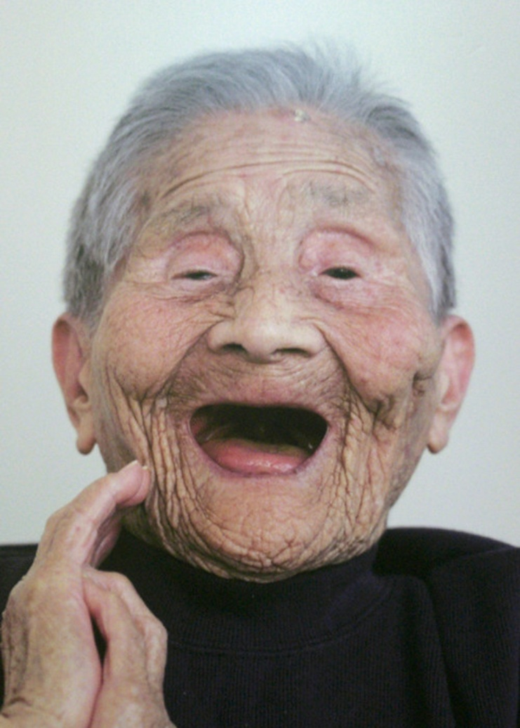
Kaku Yamanaka, 113 years old

Slide 3
Sing for Your Life!
Amazing Benefits of Music Making

Slide 4
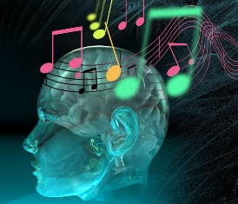

Slide 5
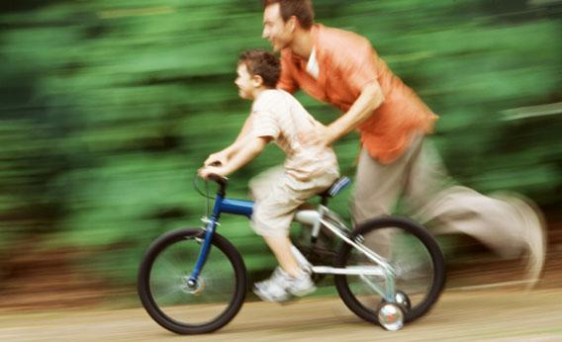

Slide 6
“General Music Track”
Most receive little or no skills-based instruction
2/3 of all students drop out of school music
by age 13
High schools teach only those who choose to
participate in ensembles and whose parents
pay for instruments and lessons
Musically illiterate population

Slide 7
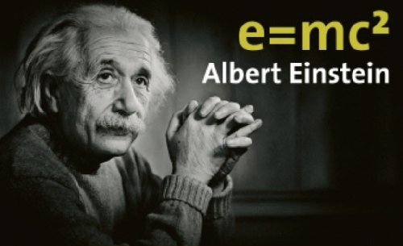

Slide 8
Problem
We are under exercised as a nation.
We look instead of play.
We ride instead of walk.
Our existence deprives ourselves of the minimum of physical activity necessary for healthy living.
President John F. Kennedy, 1961

Slide 9
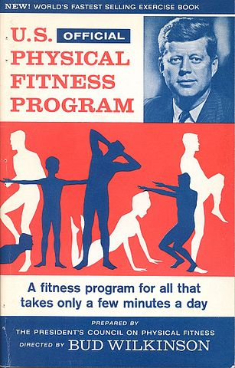
Solution

Slide 10
Current Problem
We are under achieving as a nation.
We watch instead of sing.
We listen instead of play.
Our existence deprives ourselves of the minimum of musical activity necessary for healthy living.

Slide 11
U.S. MUSICAL FITNESS PROGRAM
All people sing daily.
Every student receives sequential, skills-based
instruction by music teachers.

Slide 12
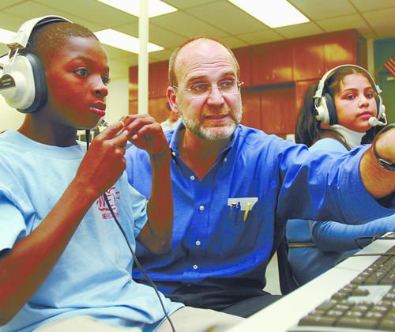

Slide 13
www.SingingCoach.com

Slide 14
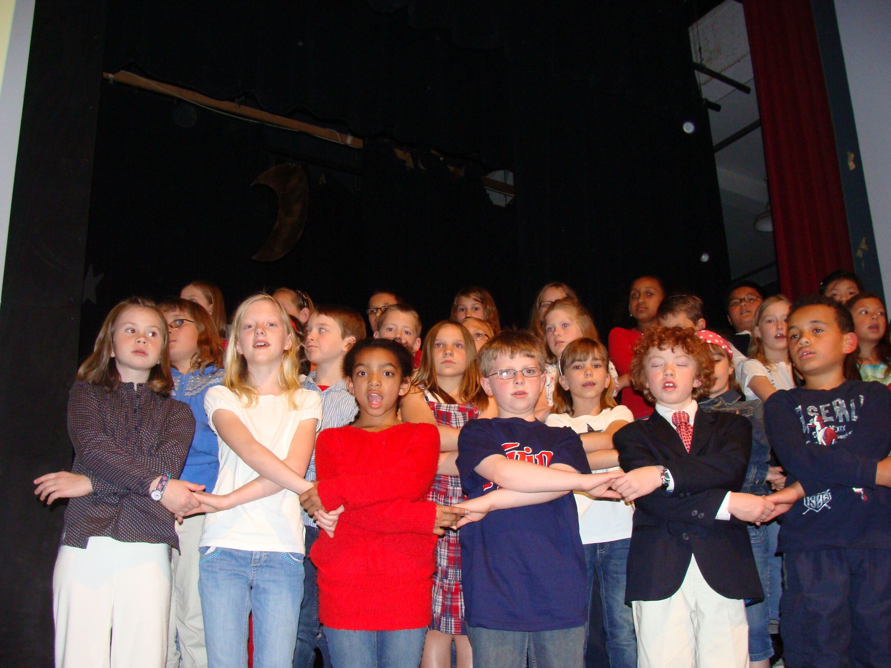
The Great American
Singing Challenge ™
A grassroots movement to get all children singing in tune

Slide 15
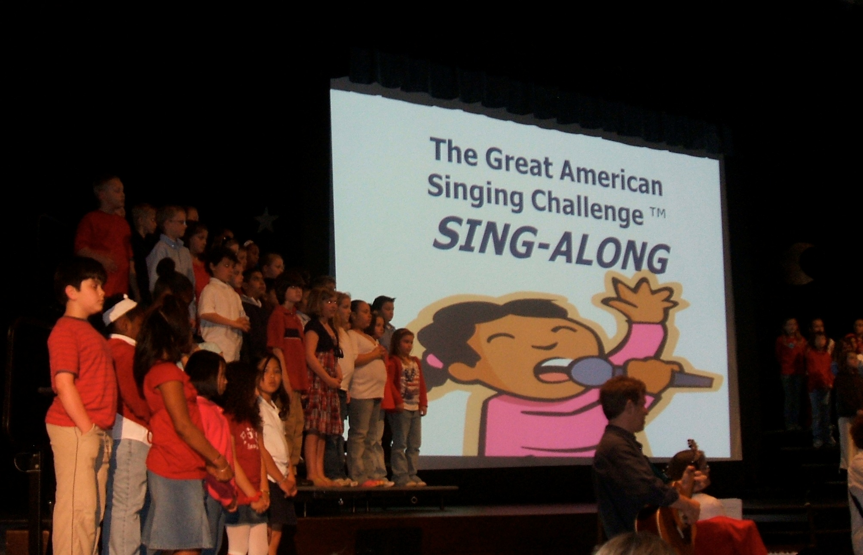
www.GreatAmericanSingingChallenge.com

Slide 16
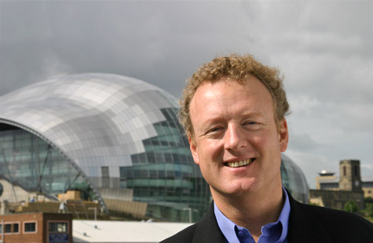
England
Howard Goodall, composer
Sing Up

Slide 17
Singing Nations Network
The Singing Nations Network is a group of organisations and individuals dedicated to singing and singing education programmes from across the world.
We meet annually to discuss our work, share our challenges and achievements and make plans to further develop singing in education.
Singing Nations Network
A group of organizations and individuals dedicated to singing and singing education
Mission: Sing for Your Life!
Vision: Within the span of a generation, hundreds of millions of children will be receiving singing education and people will be singing together.

Slide 18
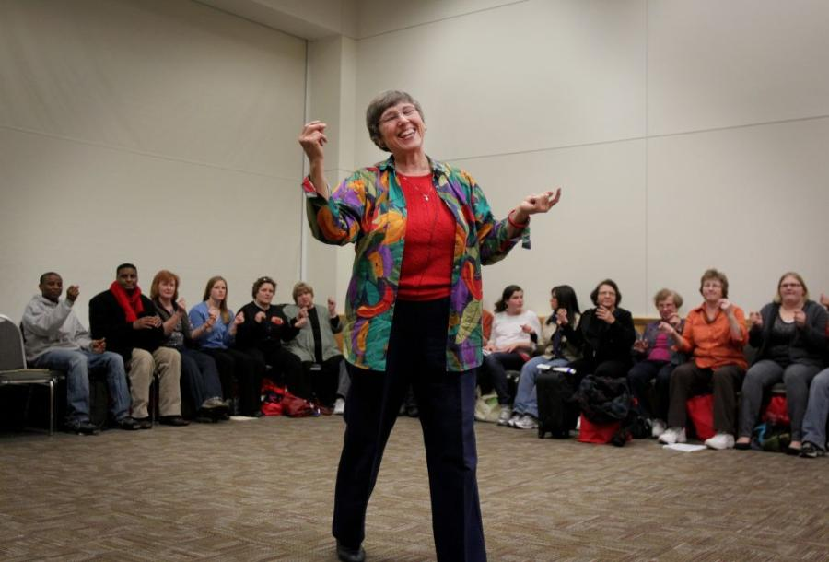
Affirming Parallel Concepts™
Elizabeth Beery Olson, Ph.D.

Slide 19
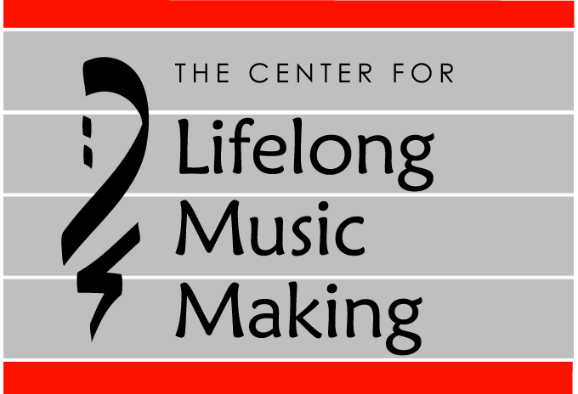
Lincoln was #1 in the increase in phonemic awareness from fall to winter…of ALL the Minneapolis schools. Coincidence?
I think not! I think singing!!!!!
www.lifelongmusicmaking.org

Slide 20
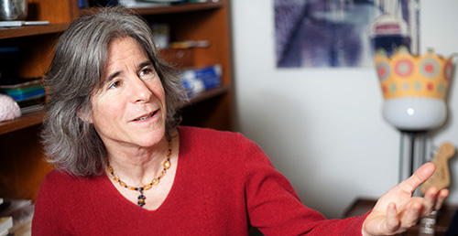
Dr. Nina Kraus, neuroscientist
1. Music training benefits academic achievement. 2. Large-scale effort to provide music instruction for every child in schools. 3. Improve the quality and quantity of music training.

Slide 21
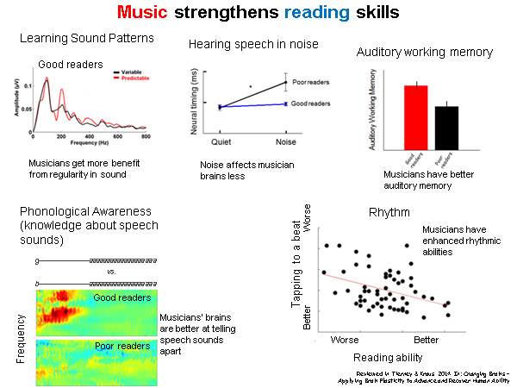

Slide 23
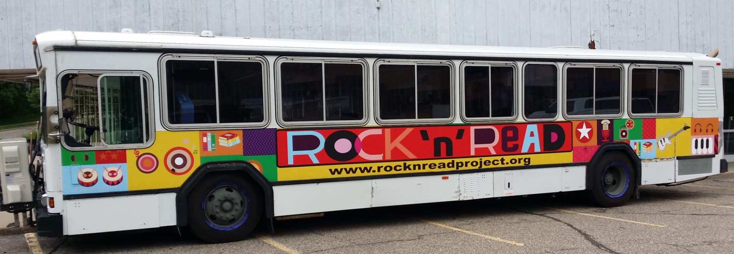
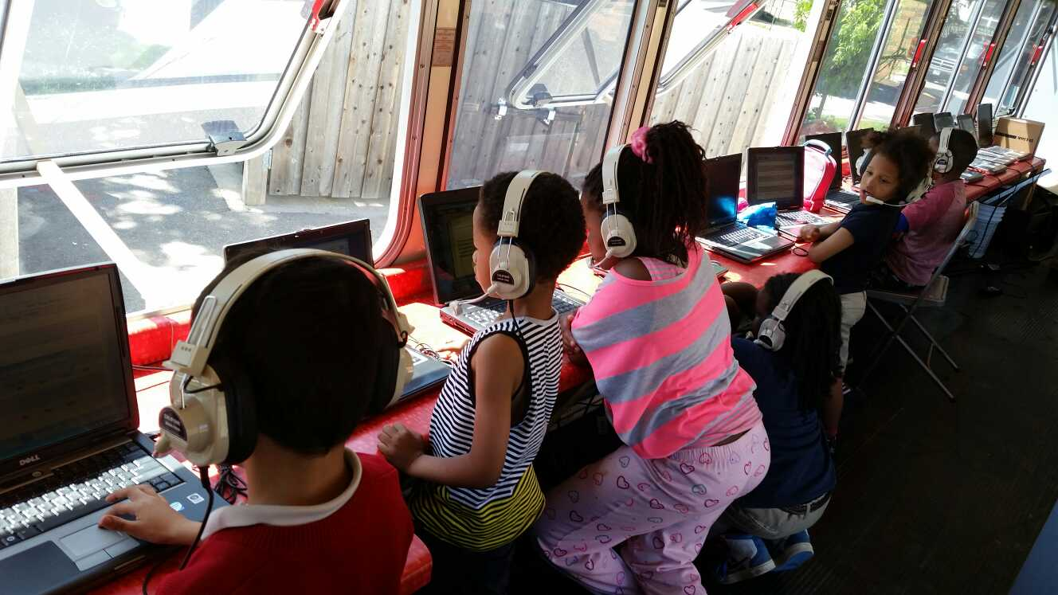
The Rock ‘n’ Read Project
www.rocknreadproject.org

Slide 24
The power of music to integrate and cure…
is quite fundamental.
It is the profoundest nonchemical medication.
~Neurologist Dr. Oliver Sachs

Slide 25
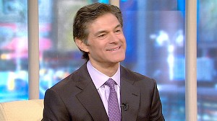
Dr. Mehmet Oz, heart surgeon
We used to spend hours asking folks to take deep breaths, and this [singing] accomplishes that goal.

Slide 26
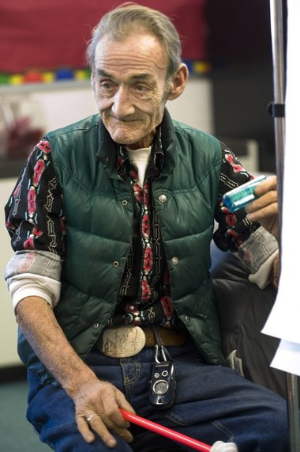
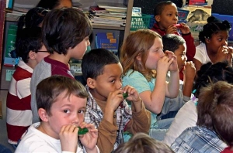
Andy Mackie

Slide 27
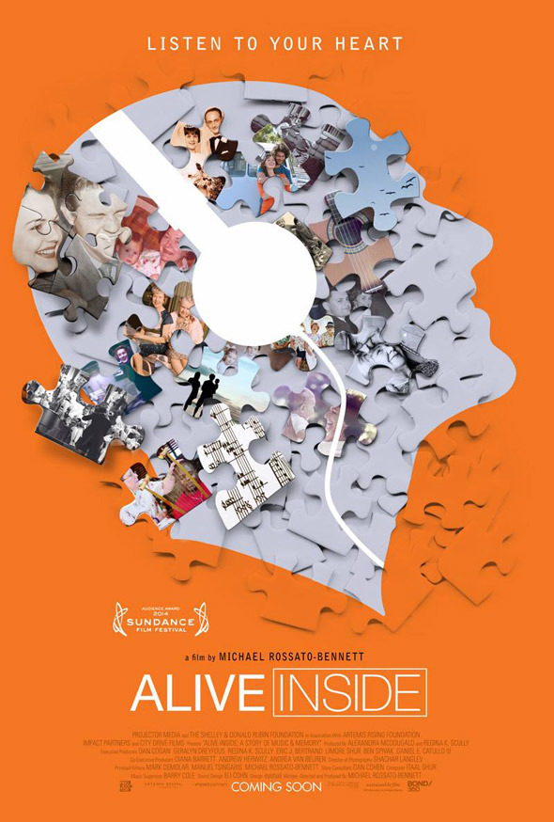
ALIVE INSIDE
Audience Award 2014
Sundance Film Festival
Music and Memory
www.musicandmemory.org

Slide 28
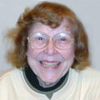
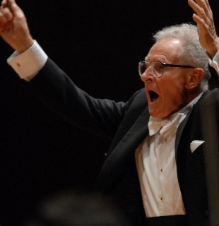
Mary West, 97
Stanislaw Skrowaczewski, 90

Slide 29
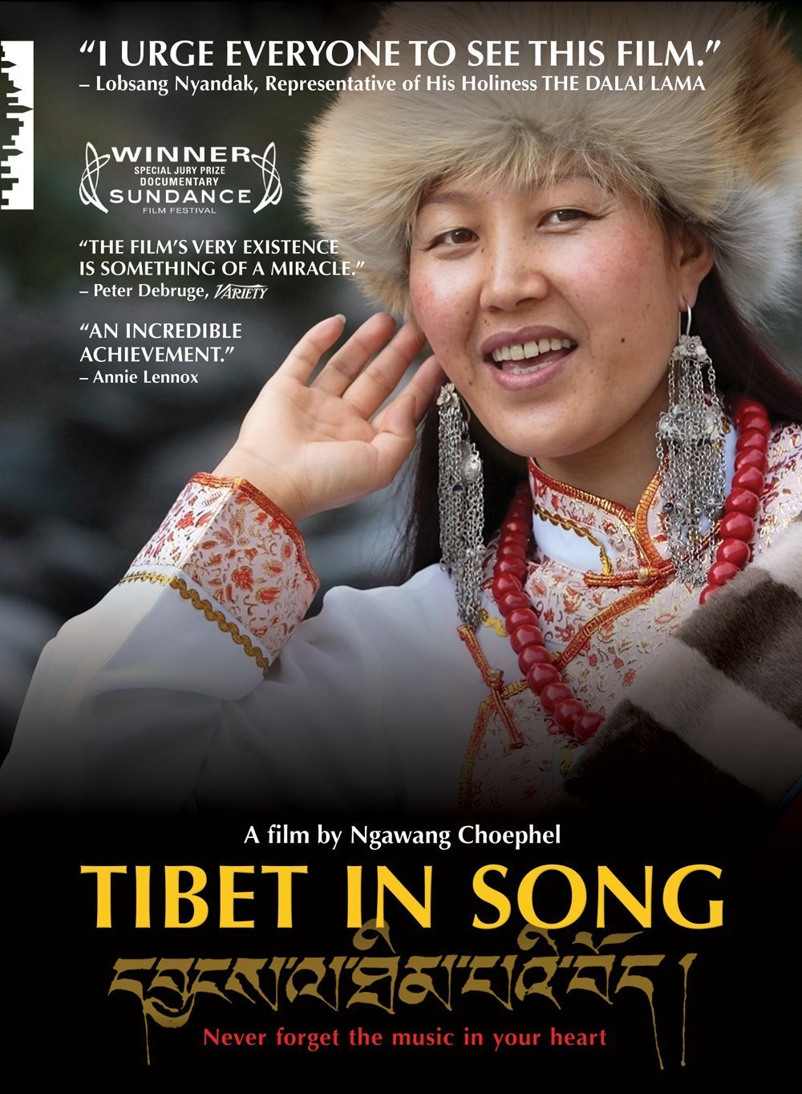
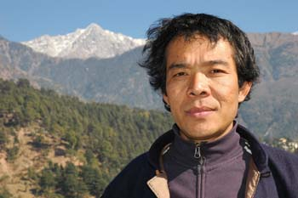
Ngawang Choephel

Slide 30
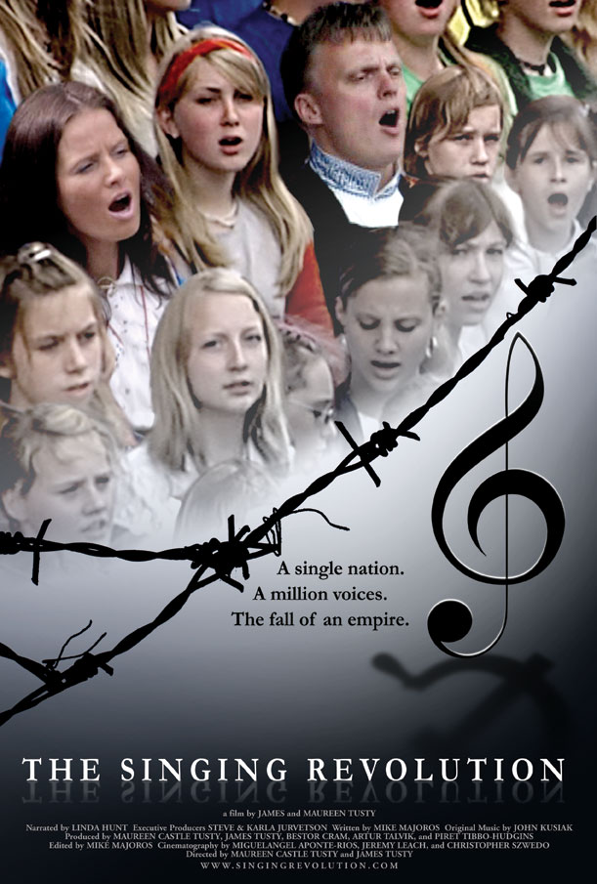
Estonia
Singing
Revolution
Independence
in 1991

Slide 31
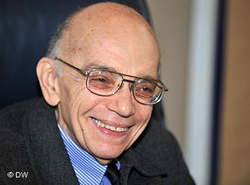
Venezuela
José Antonio Abreu
El Sistema

Slide 32
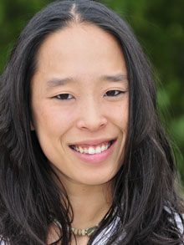
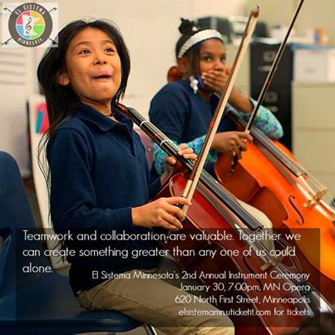
U.S.A. El Sistema Kelly Carter - Minnesota

Slide 33
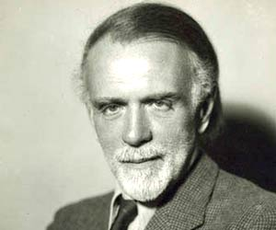
Hungary
Zoltán Kodály

Slide 34
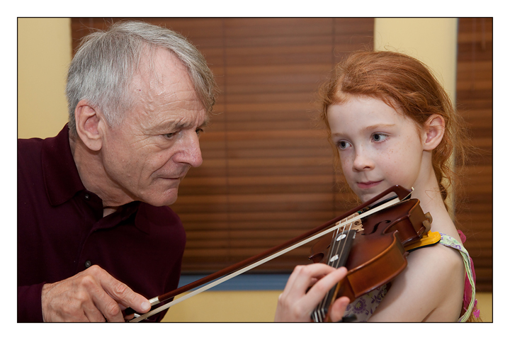
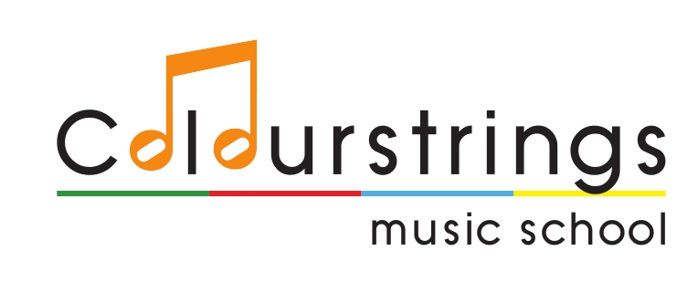
Finland
All students will master, as individuals, the basic technique of some rhythm, melody, or harmony instrument so as to be able to play in an ensemble. –National Curriculum
Géza & Csaba Szilvay

Slide 36
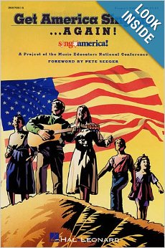
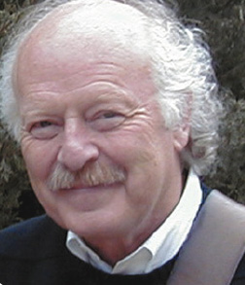
U.S.A.
Will Schmid
MENC President ‘94-’96
“It ain’t over till the audience sings”…in tune.

Slide 37
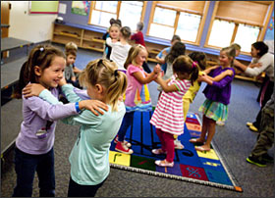
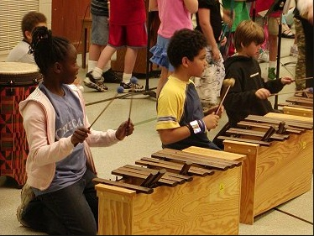
Overhaul Teacher Preparation
In-depth training in active music making approaches that leads to music competence for every child.

Slide 38
Over 50 years ago JFK
launched a fitness revolution
When will a U.S. President
call for a musical revolution?

Slide 39
Singing is the outward manifestation of our souls. It’s not a luxury, it’s not a plug-in, it’s not a nicety, it’s not a small entertainment for lunch time for some of the children. And our mission is to bring that back to our 21st-century modern communities. Singing… is our children's birthright. ~England’s Singing Ambassador
Howard Goodall

Slide 40
How Can I Keep from Singing?
My life flows on in endless song
Above earth’s lamentation;
I hear the real though far off hymn
That hails the new creation.
Through all the tumult and the strife
I hear the music ringing;
It sounds an echo in my soul,
How can I keep from singing?
Robert Wadsworth Lowry
Adapted by Pete Seeger

